Slide 1
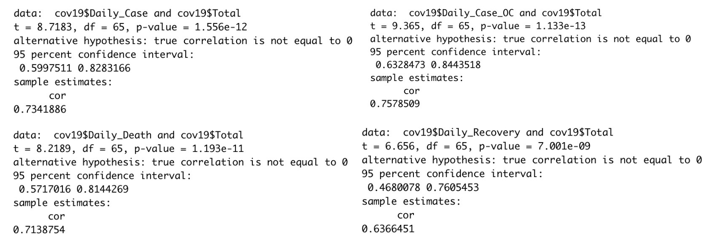
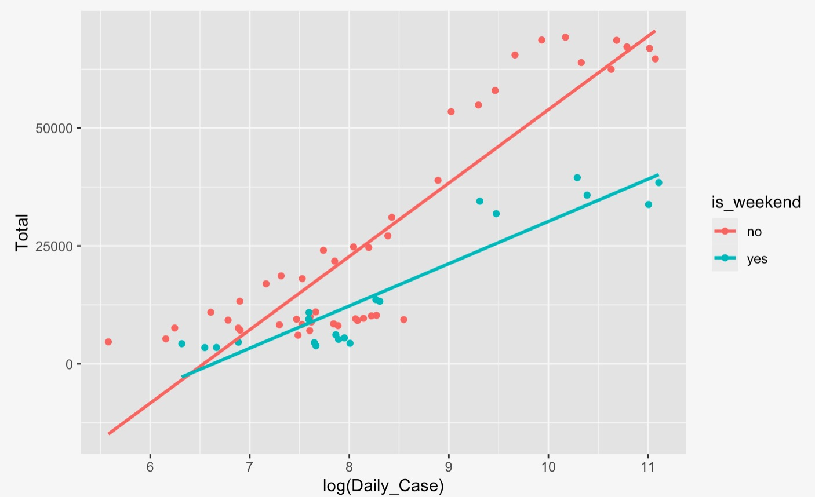
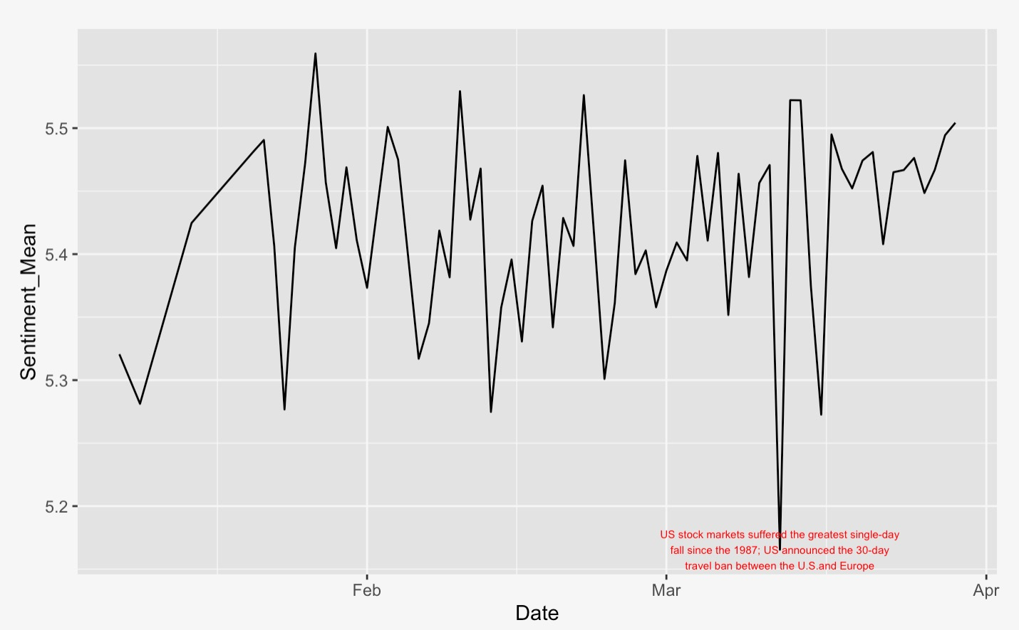
--1å
Public’s Fear On COVID-19 Over time, how did the public’s attention to COVID-19 change?
Elizabeth Park, Hao Duan, Emory University
Introduction
Does the increase in number of patients infected with the COVID-19 increase the amount of news reported?
At this moment of time, if we visit any online news platforms, we can encounter COVID-19’s impact on the world; there are articles about the COVID-19 published not even everyday but every hour and every minute. And our question is if this mass publication of news reflects the current situation of COVID-19 patients.
Results
Conclusions
There was a positive relationship between daily patient cases due to the COVID-19 and the news reported about COVID-19. Based on our study, we can conclude that mass publications of news do portray the current situation of the COVID-19 patients. However, our hypothesis that sentiment score will decrease as the situation gets worse, did not hold true. There existed almost no correlation in the tone news were reported with the patient cases. We also have to take into consideration that since this is a current situation, data fluctuates frequently and sample size (n = 66) is relatively small. Based on our findings in this study, further studies can be operated such as seeing whether such positive relationship of news publication holds true for other new worldwide phenomena such as eruptions and flood.
Figure 1: Correlation Tests of Daily Patient, Death, Recovery Cases with Total Number of News Reported
Figure 1 shows the relationship of the total number of news reported with 4 different variables: daily patient case, daily patient case outside China, daily death, and daily recovery, respectively.
The output suggests that the all 4 variables show a positive correlation with the total number of news reported with significance.
Hypotheses
Our hypothesis is that as the number of patients and the number of deaths due to COVID-19 increases, the number of news mentioning the word “coronavirus” will also increase.
Figure 2: Regression Analysis of Daily Patient Case and Total Number of News Reported
Figure 2 illustrates the regression of total number of news reported on the daily patient case. Since we found that there exists a huge difference between the amount of news reported on weekdays and weekends, we grouped the data by weekends and weekdays.
From Figure 2, we can observe that there is a positive trend in total number of news on daily patient case. Furthermore, weekdays have more news published than during the weekends.
We have also predicted that the points below the red fitted line are scattered since those points represent early dates in the spread of COVID-19, which was especially cases in China, meaning less news reports in English.
Materials and methods
To analyze our question of interest, we collected data on the number of coronavirus patients, number of deaths due to coronavirus, number of patients cured, and number of news mentioning the word ‘coronavirus’ by date. To collect the data set about the patients, we’ve used the data from Worldometer.info. For the number of news, we searched for the keyword “coronavirus” through LexisNexis by date.
With the collected data, we first tested the correlation between the number of news mentioning the word ‘coronavirus’ and the number of patients with COVID-19. Then, we operated a regression analysis for those variables. We also ran the sentiment analysis to find the change of sentiment of those news over time.
References
Coronavirus Cases. (n.d.). Retrieved from
https://www.worldometers.info/coronavirus/coronavirus-cases/
Figure 3: Sentiment Analysis of Daily News Reported on the COVID-19
In a sentiment analysis, scale of 5.0 represents neutral tone of the text.
As shown in Figure 3, most of the news reported on the subject COVID-19 represented a neutral tone, varying from about 5.0 to about 5.6. However, there were points where there existed drastic drops of sentiment scale such as in March 12th. We have predicted that such fall towards the negative tone might have been due to Black Thursday, which was a global stock market crash on March 12; US stock markets suffered from the greatest single-day percentage fall since the 1987 stock market crash.
Acknowledgments
We thank Dr. Ben Miller and Dr. Roberto Franzosi for useful discussions and for providing resources.
Contacts
Elizabeth Park: elizabeth.park@emory.edu Hao Duan: hao.duan@emory.edu

